Slide 1
Cloud Infrastructure
Module 3

Slide 2
What is cloud infrastructure?
Cloud infrastructure refers to the hardware and software components, such as servers, storage, networking, virtualization software, services and management tools, that support the computing requirements of a cloud computing model.
In a cloud computing architecture, cloud infrastructure refers to the back-end technology elements found within most enterprise data centers
Major Components of the data center:
Server Farm
Network Infrastructure
Storage Systems

Slide 3
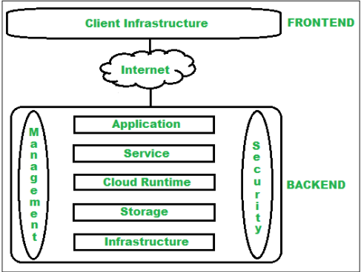
Architecture of Cloud Computing

Slide 4
Architecture of Cloud Computing
Frontend :
Frontend of the cloud architecture refers to the client side of cloud computing system. Means it contains all the user interfaces and applications which are used by the client to access the cloud computing services/resources.
For example use of a web browser to access the cloud platform.
https://azure.microsoft.com/en-in/features/azure-portal/
Client Infrastructure
Client Infrastructure refers to the frontend components. It contains the applications and user interfaces which are required to access the cloud platform.

Slide 5
Architecture of Cloud Computing
Backend
Backend refers to the cloud itself which is used by the service provider. It contains the resources as well as manages the resources and provides security mechanisms. Along with this it includes huge storage, virtual applications, virtual machines, traffic control mechanisms, deployment models etc.
https://aws.amazon.com/s3/
https://aws.amazon.com/ec2/instance-types/
https://azure.microsoft.com/en-in/services/virtual-machines/#features

Slide 6
Architecture of Cloud Computing
Backend
Application -
Application in backend refers to a software or platform to which client accesses. Means it provides the service in backend as per the client requirement.
Service –
Service in backend refers to the major three types of cloud based services like SaaS, PaaS and IaaS. Also manages which type of service the user accesses.
Cloud Runtime –
Runtime cloud in backend refers to provide of execution and runtime platform/environment to the virtual machine.
Storage –
Storage in backend refers to provide flexible and scalable storage service and management of stored data.

Slide 7
Architecture of Cloud Computing
Backend
Infrastructure –
Cloud Infrastructure in backend refers to hardware and software components of cloud like it includes servers, storage, network devices, virtualization software etc.
Management –
Management in backend refers to management of backend components like application, service, runtime cloud, storage, infrastructure, and other security mechanisms etc.
Security –
Security in backend refers to implementation of different security mechanisms in the backend for secure cloud resources, systems, files, and infrastructure to end-users.
Internet –
Internet connection acts as the medium or a bridge between frontend and backend and establishes the interaction and communication between frontend and backend.

Slide 8
The three layers of cloud computing
Infrastructure cloud: Abstracts applications from servers and servers from storage
Content cloud: Abstracts data from applications
Information cloud: Abstracts access from clients to data
The three cloud implementation models are:
Private cloud: Created and run internally by an organization or purchased and stored within the organization and run by a third party.
Hybrid cloud: Outsources some but not all elements either internally or externally
Public cloud: No physical infrastructure locally, all access to data and applications is external

Slide 9
The three layers of cloud computing
An infrastructure cloud includes the physical components that run applications and store data.
Virtual servers are created to run applications, and virtual storage pools are created to house new and existing data into dynamic tiers of storage based on performance and reliability requirements.
Virtual abstraction is employed so that servers and storage can be managed as logical rather than individual physical entities

Slide 10
Virtual servers
A virtual server is a server that shares hardware and software resources with other operating systems (OS), versus dedicated servers. Because they are cost-effective and provide faster resource control, virtual servers are popular in Web hosting environments.

Slide 11
The three layers of cloud computing
The content cloud implements metadata and indexing services over the infrastructure cloud to provide abstracted data management for all content.
The goal of a content cloud is to abstract the data from the applications so that different applications can be used to access the same data, and applications can be changed without worrying about data structure or type.
The content cloud transforms data into objects so that the interface to the data is no longer tied to the actual access to the data, and the application that created the content in the first place can be long gone while the data itself is still available and searchable.

Slide 12
The three layers of cloud computing
The information cloud is the ultimate goal of cloud computing and the most common from a public perspective.
The information cloud abstracts the client from the data.
For example, a user can access data stored in a database in Singapore via a mobile phone in Atlanta, or watch a video located on a server in Japan from his a laptop in the U.S.
The information cloud abstracts everything from everything.
The Internet is an information cloud.

Slide 13
Design Challenges
Data Security and Privacy
Cost Management
Multi-Cloud Environments
Performance Challenges
Interoperability and Flexibility
High Dependence on Network
Lack of Knowledge and Expertise

Slide 14
Data Security and Privacy
User or organizational data stored in the cloud is critical and private.
Even if the cloud service provider assures data integrity, it is your responsibility to carry out user authentication and authorization, identity management, data encryption, and access control.
Security issues on the cloud include identity theft, data breaches, malware infections, and a lot more which eventually decrease the trust amongst the users of your applications.
This can in turn lead to potential loss in revenue alongside reputation and stature. Also, dealing with cloud computing requires sending and receiving huge amounts of data at high speed, and therefore is susceptible to data leaks.

Slide 15
Cost Management
Even as almost all cloud service providers have a “Pay As You Go” model, which reduces the overall cost of the resources being used, there are times when there are huge costs incurred to the enterprise using cloud computing.
When there is under optimization of the resources, let’s say that the servers are not being used to their full potential, add up to the hidden costs.
If there is a degraded application performance or sudden spikes or overages in the usage, it adds up to the overall cost.
Unused resources are one of the other main reasons why the costs go up. If you turn on the services or an instance of cloud and forget to turn it off during the weekend or when there is no current use of it, it will increase the cost without even using the resources.

Slide 16
Multi-Cloud Environments
Due to an increase in the options available to the companies, enterprises not only use a single cloud but depend on multiple cloud service providers.
Most of these companies use hybrid cloud tactics and close to 84% are dependent on multiple clouds.
This often ends up being hindered and difficult to manage for the infrastructure team. The process most of the time ends up being highly complex for the IT team due to the differences between multiple cloud providers.

Slide 17
Performance Challenges
Performance is an important factor while considering cloud-based solutions. If the performance of the cloud is not satisfactory, it can drive away users and decrease profits.
Even a little latency while loading an app or a web page can result in a huge drop in the percentage of users.
This latency can be a product of inefficient load balancing, which means that the server cannot efficiently split the incoming traffic so as to provide the best user experience.
Challenges also arise in the case of fault tolerance, which means the operations continue as required even when one or more of the components fail.

Slide 18
Interoperability and Flexibility
When an organization uses a specific cloud service provider and wants to switch to another cloud-based solution, it often turns up to be a tedious procedure since applications written for one cloud with the application stack are required to be re-written for the other cloud.
There is a lack of flexibility from switching from one cloud to another due to the complexities involved.
Handling data movement, setting up the security from scratch and network also add up to the issues encountered when changing cloud solutions, thereby reducing flexibility.

Slide 19
High Dependence on Network
Since cloud computing deals with provisioning resources in real-time, it deals with enormous amounts of data transfer to and from the servers.
This is only made possible due to the availability of the high-speed network. Although these data and resources are exchanged over the network, this can prove to be highly vulnerable in case of limited bandwidth or cases when there is a sudden outage.
Even when the enterprises can cut their hardware costs, they need to ensure that the internet bandwidth is high as well there are zero network outages, or else it can result in a potential business loss.
It is therefore a major challenge for smaller enterprises that have to maintain network bandwidth that comes with a high cost.

Slide 20
Lack of Knowledge and Expertise
Due to the complex nature and the high demand for research working with the cloud often ends up being a highly tedious task.
It requires immense knowledge and wide expertise on the subject. Although there are a lot of professionals in the field they need to constantly update themselves.
Cloud computing is a highly paid job due to the extensive gap between demand and supply. There are a lot of vacancies but very few talented cloud engineers, developers, and professionals.
Therefore, there is a need for upskilling so these professionals can actively understand, manage and develop cloud-based applications with minimum issues and maximum reliability.

Slide 21
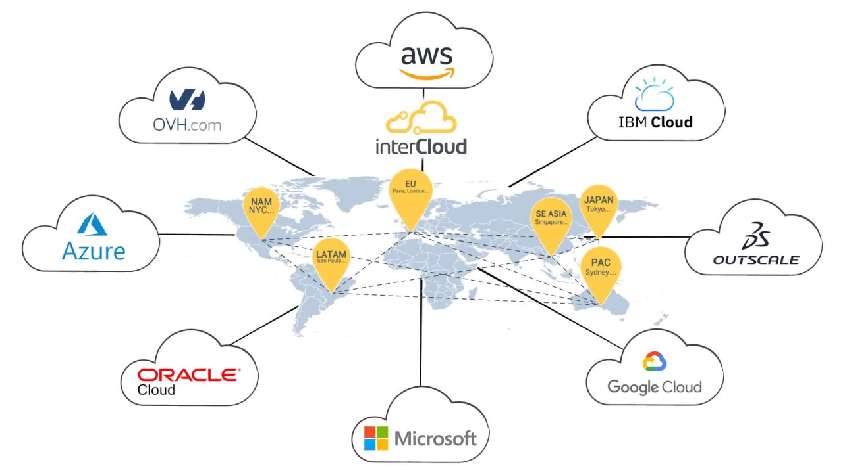
Cloud of Clouds (Intercloud)

Slide 22
Cloud of Clouds (Intercloud)
Intercloud or ‘cloud of clouds’ is a term refer to a theoretical model for cloud computing services based on the idea of combining many different individual clouds into one seamless mass in terms of on-demand operations.
The intercloud would simply make sure that a cloud could use resources beyond its reach, by taking advantage of pre-existing contracts with other cloud providers.
The Intercloud scenario is based on the key concept that each single cloud does not have infinite physical resources or ubiquitous geographic footprint.
If a cloud saturates the computational and storage resources of its infrastructure, or is requested to use resources in a geography where it has no footprint, it would still be able to satisfy such requests for service allocations sent from its clients.

Slide 23
Inter-Cloud
Definition: The idea behind an inter-cloud is that a single common functionality would combine many different individual clouds into one seamless mass in terms of on-demand operations.
Terms like rapid elasticity, resource pooling and on-demand self-service are already part of cloud hosting service designs that are set up to make sure the customer or client never has to deal with limitations or disruptions.

Slide 24
Cloud of Clouds (Intercloud)
The Intercloud scenario would address such situations where each cloud would use the computational, storage, or any kind of resource (through semantic resource descriptions, and open federation) of the infrastructures of other clouds.
This is analogous to the way the Internet works, in that a service provider, to which an endpoint is attached, will access or deliver traffic from/to source/destination addresses outside of its service area by using Internet routing protocols with other service providers with whom it has a pre-arranged exchange or peering relationship.
It is also analogous to the way mobile operators implement roaming and inter-carrier interoperability. Such forms of cloud exchange, peering, or roaming may introduce new business opportunities among cloud providers if they manage to go beyond the theoretical framework.

Slide 25
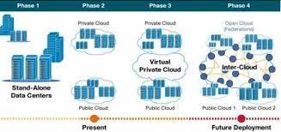

Slide 26
Inter Cloud Design Objectives
Shifting computing from desktops to data centers
Service provisioning and cloud economics
Scalability in performance
Data privacy protection
High quality of cloud services
New standards and interfaces

Slide 27
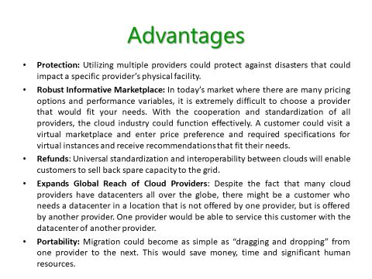

Slide 28
Challenges
Identification: The first step is to create a system where each cloud can be identified and accessed by another cloud.
Acceptance of Standards: The IEEE is working on standards for the cloud, the question remains if these standards will be accepted by all. These standards cannot be enforced, so each cloud provider needs to accept these standards in order for the needle to move. Furthermore, as these standards are being developed, technology is advancing which might make the new standards obsolete.
Communication: Clouds will need to talk to each other to verify each other’s available resources. This requires creating a universal language among the clouds.
Architecture: The ability for clouds to corroborate(support) and share assets is not sufficient, this process needs to be cost-effective and simple. Clouds would need to be re-architected in order to create a user friendly Intercloud that is significantly cheaper than the current system.
Payment: When one provider uses the assets of another provider, a questions arises on how will the second provider be compensated, and who will be responsible for the SLAs?

Slide 29
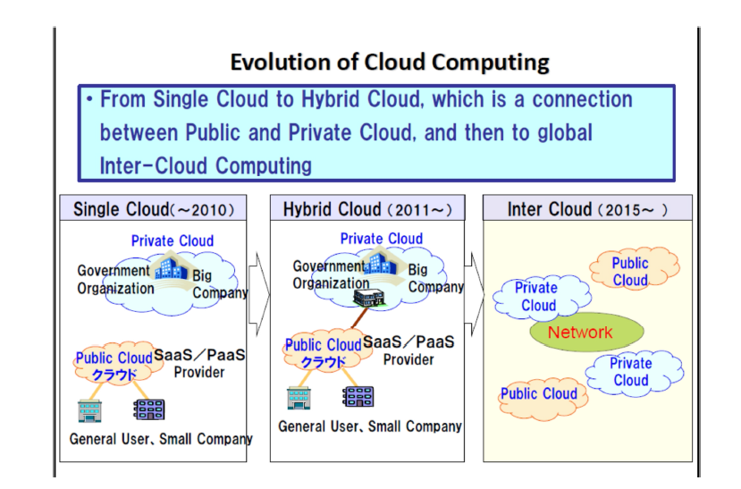

Slide 30
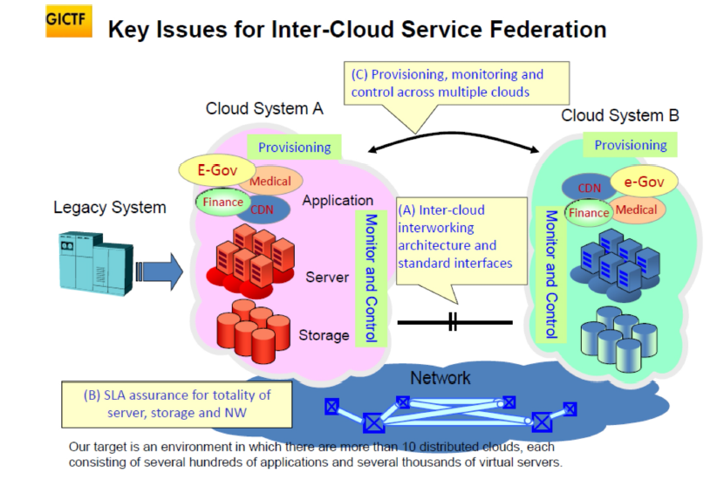

Slide 31
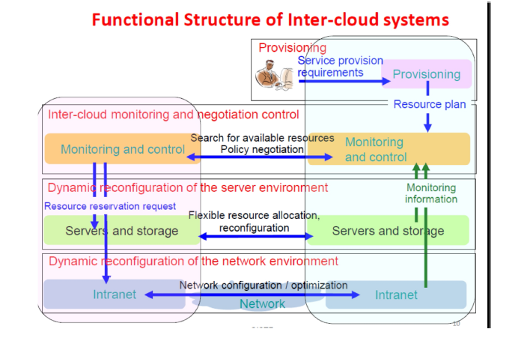

Slide 32
Inter Cloud Resource Management
The cloud infrastructure layer can be divided as Data as a Service (DaaS) and Communication as a Service (CaaS) in addition to compute and storage in IaaS.
Cloud players are divided into three classes:
(1) cloud service providers and IT administrators,
(2) software developers or vendors, and
(3) end users or business users.
• These cloud players vary in their roles under the IaaS, PaaS, and SaaS models.

Slide 33
Inter Cloud Resource Management
From the software vendors’ perspective, application performance on a given cloud platform is most important.
From the providers’ perspective, cloud infrastructure performance is the primary concern.
From the end users’ perspective, the quality of services, including security, is the most important
Developers have to consider how to design the system to meet critical requirements such as high throughput, High Availability, and fault tolerance.
Even the operating system might be modified to meet the special requirement of cloud data processing.

Slide 34
Inter Cloud Resource Management
Runtime Support Services
• As in a cluster environment, there are also some runtime supporting services in the cloud computing environment.
• Cluster monitoring is used to collect the runtime status of the entire cluster.
• The scheduler queues the tasks submitted to the whole cluster and assigns the tasks to the processing nodes according to node availability.
• Runtime support is software needed in browser-initiated applications applied by thousands of cloud customers.

